Slide 1
Ad Hoc WLAN
- Varun Kumar Mishra (62)
- Prashu Chaudhry (38)

Slide 2
Intro
WLANs can be broadly classified into two types
Infrastructure networks
Ad Hoc Networks.
Infrastructure networks contain special nodes called access points (APs), which are connected via existing networks.
Ad hoc LANs do not need any fixed infrastructure.

Slide 3
Infrastructure Network
Infrastructure networks contain special nodes called access points (APs), which are connected via existing networks.
APs are special in the sense that they can interact with wireless nodes as well as with the existing wired network.
The other wireless nodes, also known as mobile stations (STAs), communicate via APs.
The APs also act as bridges with other networks.

Slide 4
Ad Hoc Networks
Ad hoc LANs do not need any fixed infrastructure.
These networks can be set up on the fly at any place.
Nodes communicate directly with each other or forward messages through other nodes that are directly accessible.

Slide 5
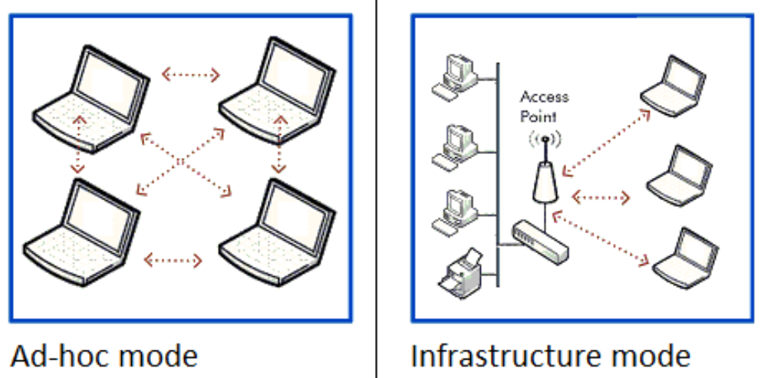
Ad-hoc Mode vs Infrastructure Mode

Slide 6
How Ad Hoc Network Works ?
Devices in the ad hoc network require a wireless network adapter or chip, and they need to be able to act as a wireless router when connected.
When setting up a wireless ad hoc network, each wireless adapter must be configured for ad hoc mode instead of infrastructure mode.
All wireless adapters need to use the same service set identifier (SSID) and wireless frequency channel number.

Slide 7
Working
Instead of relying on a wireless base station to coordinate the flow of messages to each node in the network, the individual nodes in ad hoc networks forward packets to and from each other.
Makeshift by nature, ad hoc wireless networks are useful where there is not a wireless structure built -- for example, if there aren't any access points or routers within range and cabling cannot be extended to reach the location where additional wireless communication is needed.

Slide 8
Types of Ad Hoc Networks
Choosing a wireless ad hoc network type depends on the wireless equipment capabilities, physical environment and purpose of the communication.
MANET. A mobile ad hoc network involves mobile devices communicating directly with one another.
IMANETs. Internet-based mobile ad hoc networks support internet protocols, such as TCP/IP (Transmission Control Protocol/Internet Protocol) and User Datagram Protocol (UDP).

Slide 9
Types
SPANs. Smartphone ad hoc networks employ existing hardware, such as Wi-Fi and Bluetooth, and software protocols built into a smartphone operating system (OS) to create P2P networks without relying on cellular carrier networks, wireless access points or other traditional network infrastructure equipment.
Vehicular ad hoc network. This network type involves devices in vehicles that are used for communicating between them and roadside equipment. An example is the in-vehicle safety and security system, OnStar.

Slide 10
Advantages
No special infrastructure needed as such.
Easy to setup .
Cost efficient .
Fast network establishment.
Peer to peer connectivity.
No need of central servers.
Independent computations.

Slide 11
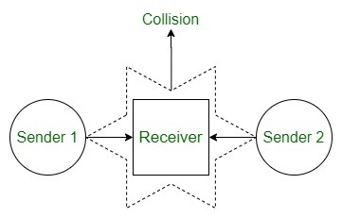
Problems
Limited wireless range.
Packet Losses.
Energy conservation because of limited batteries.
Low Quality Communication.
Hidden node problem, this might create collision If two device try to communicate with same receiver.

Slide 12
Disadvantages
Topology
Security
Bandwidth
Energy
Routing

Slide 13
Disadvantages
One major drawback of wireless ad hoc networking is that some Wi-Fi-enabled technology, including certain Android devices, wireless printers and custom IoT sensors, don't support ad hoc mode because of its limitations and will only connect to networks in infrastructure mode by default. In some cases, third-party software can be installed on endpoint devices to enable ad hoc communications.
Infrastructure mode is a better option than ad hoc mode for setting up a larger and more permanent network that can support far more endpoints.

Slide 14
Usage
Deciding when to employ ad hoc versus infrastructure mode depends on the use.
A user who wants a wireless router to act as a permanent access point should choose infrastructure mode.
But ad hoc mode might be a good option for a user setting up a temporary wireless network between a small number of devices.
They require minimal configuration and can be deployed quickly, which makes them suitable for emergencies, such as natural disasters or military conflicts.

Slide 15
Applications
Military
Personal Area Network (PAN).
Crisis Conditions
Medical Applications
Environmental Applications

Slide 16


